Slide 1
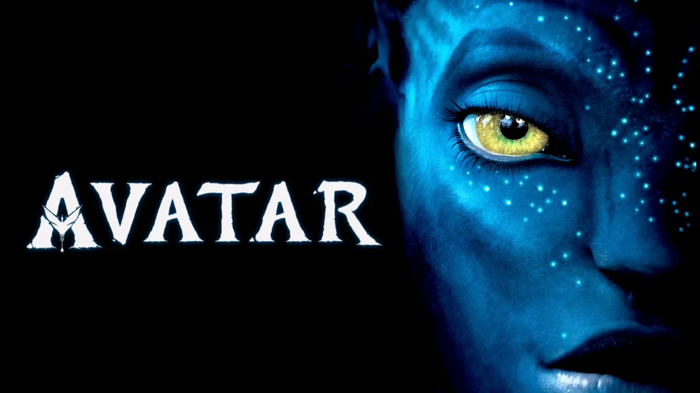
This movie name is “AVATAR 2
Notes:
This movie name is “AVATAR 2”

Slide 2
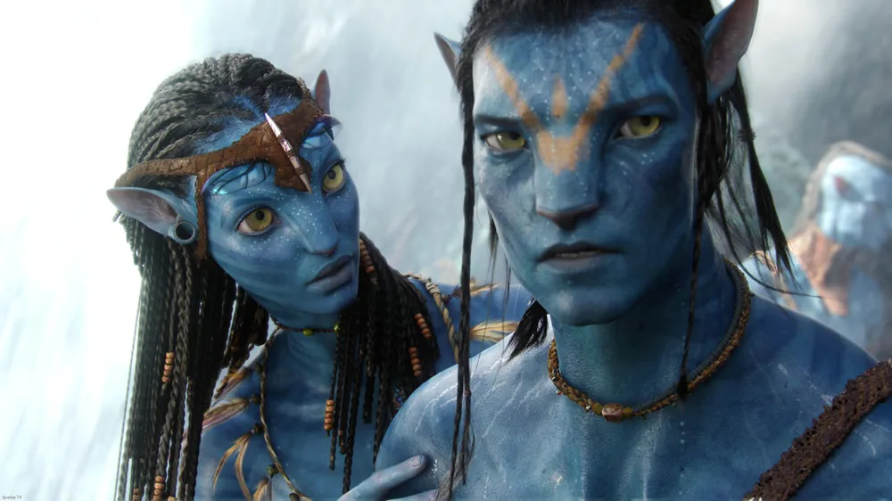
This movies came out 2022
Notes:
This movies came out 2022

Slide 3
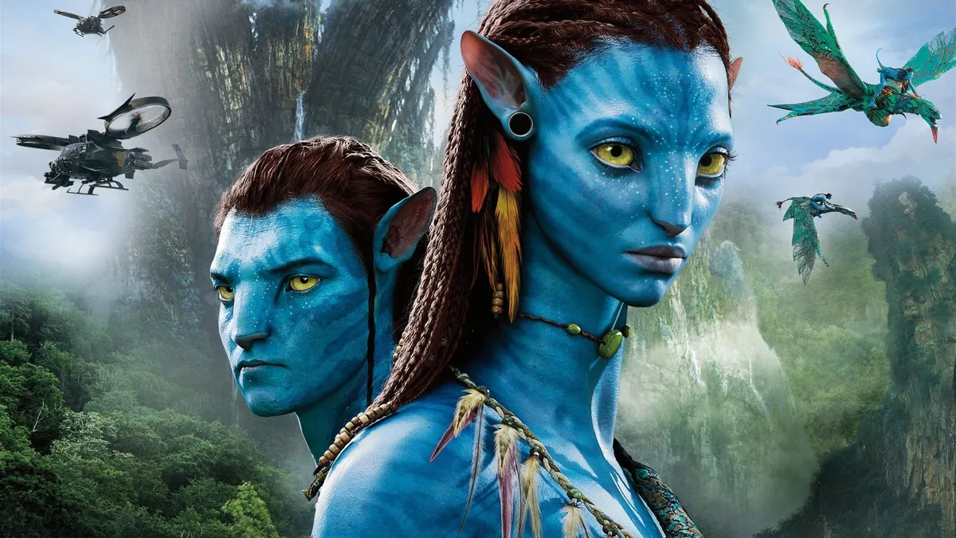
BUDGET THIS MOVIE BE 350-460MILLION
BOX OFFICE:2.320BILLION
Notes:
BUDGET THIS MOVIE BE 350-460MILLION
BOX OFFICE:2.320BILLION
ITS VERY BIG SUM

Slide 4
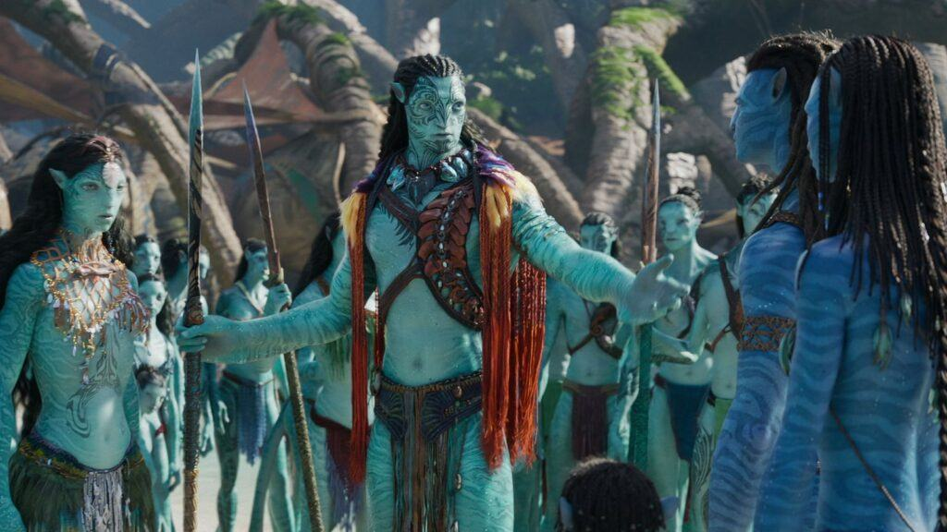
Movies genre is:FANTASTIK
Why this movie like me because i am like fantastik movies
Notes:
Movies genre is:FANTASTIK
Why this movie like me because i am like fantastik movies

Slide 5
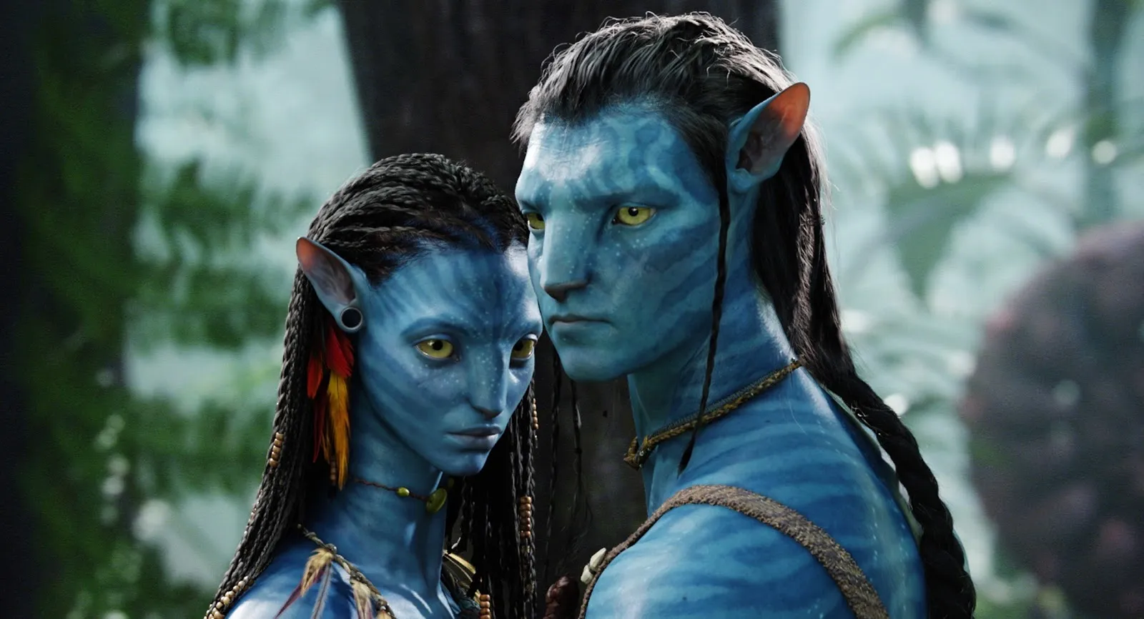
Directed by:James Cameron
James 70years old
His budget is:237milion$$$$$$$$
Notes:
Directed by:James Cameron
James 70years old
His budget is:237milion$$$$$$$$

Slide 6
Main character:Sam Warthington,Zoe Saldana
Notes:
Main character:Sam Warthington,Zoe Saldana

Slide 7
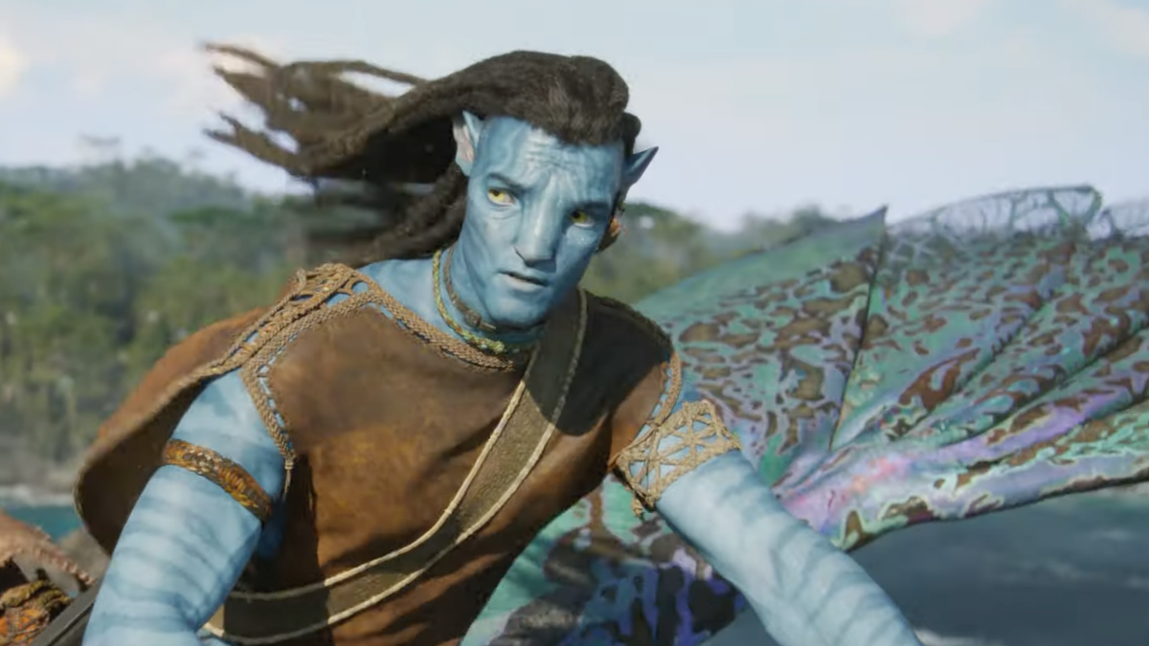
This presentation
Directed By:MUSA ESHANKULOV
Notes:
This presentation
Directed By:MUSA ESHANKULOV

